Slide 1
Extracting & Storing Data
Jeremy Bergmann - Omaha Data Science Academy

Slide 2
Review: Class 2 - Writing Queries
What are the common SQL clauses?
What are the common aggregations/functions?
How to you utilize comments for debugging or explaining code?
What are the various SQL function types?
Aggregate Functions (Groupings): SUM, AVG, MIN/MAX, etc.
Value/Scalar Functions (Changing Values): String, Date, Math, etc.
Notes:
SELECT column
FROM table_name
WHERE conditions
GROUP BY column
ORDER BY column
Write a summary of the information as if explaining to a 14 year old. Avoid jargon Keep the words and sentences simple Rely on memory Make the explanation visual, if possible Note where you had difficulty or have knowledge gaps. These indicate things you should review, research, or ask questions about

Slide 3
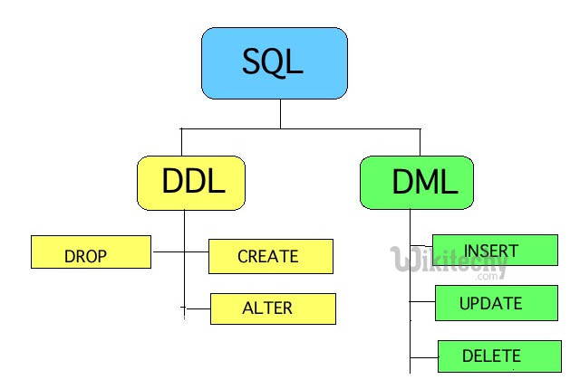
Class 3 Objectives
Data Storage
Create and delete databases
Create and delete tables & views
Create tables with constraints
Add and delete table fields
Add and delete table constraints
Insert, Update, Delete data from tables
Import data from SQL and CSV files
Notes:
DDL is Data Definition Language
DML is Data Manipulation Language

Slide 4
What is the need for data manipulation?
Creating new datasets & Combine disparate data sets
Perform common queries, aggregations, and joins
Adding, removing, or modifying data
Extracting and Storing Data
Creation/Extraction
Transforming data
Manipulating data
Storage & Retrieval
Notes:
Creation: creating tables and databases, the things
Storage: where data are stored
Cleaning: adding, removing, or modifying data
Retrieval: selecting only the data you want

Slide 5
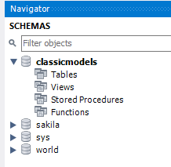
Create a New Database/Schema
Purpose - Creating a container for persistent Data Storage & Retrieval.
Database Description
The classicmodels database is a retailer of scale models of classic cars database. It contains typical business data such as customers, products, sales orders, sales order line items, etc.
Code
CREATE DATABASE classicmodels;
USE classicmodels;
See the full classicmodels schema at:
http://www.mysqltutorial.org/mysql-sample-database.aspx
Notes:
CREATE DATABASE classicmodels;
USE classicmodels;

Slide 6
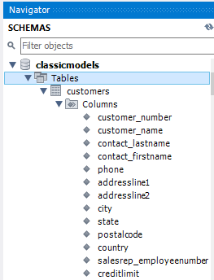
Creating Tables
Purpose - Creating a tabular structure for persistent Data Storage & Retrieval.
CREATE TABLE classicmodels.customers ( customer_number INT NOT NULL, customer_name VARCHAR(50) NOT NULL, contact_lastname VARCHAR(50) NOT NULL, contact_firstname VARCHAR(50) NOT NULL, phone VARCHAR(50) NOT NULL, addressline1 VARCHAR(50) NOT NULL, addressline2 VARCHAR(50) DEFAULT NULL, city VARCHAR(50) NOT NULL, state CHAR(2) DEFAULT 'NE', postalcode VARCHAR(15) DEFAULT NULL, country CHAR(3)NOT NULL DEFAULT 'USA', salesrep_employeenumber INT DEFAULT NULL, creditlimit DECIMAL(10,2) CHECK (creditlimit < 1000000), PRIMARY KEY (customer_number));
Table & Field Names
Constraints
Table Keys - Primary & Foreign
Notes:
USE jbergmann; * Note: Create table in your given user schema (ex. Jbergmann)
CREATE TABLE jbergmann.customers (
customer_number INT NOT NULL UNIQUE,
customer_name VARCHAR(50) NOT NULL,
contact_lastname VARCHAR(50) NOT NULL,
contact_firstname VARCHAR(50) NOT NULL,
phone VARCHAR(50) NOT NULL,
addressline1 VARCHAR(50) NOT NULL,
addressline2 VARCHAR(50) DEFAULT NULL,
city VARCHAR(50) NOT NULL,
state CHAR(2) DEFAULT NULL,
postalcode VARCHAR(15) DEFAULT NULL,
country CHAR(3) NOT NULL DEFAULT 'USA',
salesrep_employeenumber INT DEFAULT NULL,
creditlimit DECIMAL(10,2) CHECK (creditlimit < 1000000),
PRIMARY KEY (customer_number)
);
/* Constraints are the rules enforced on the data columns of a table.
Types of Constraints: https://www.tutorialspoINT.com/sql/sql-constraINTs.htm */

Slide 7
SQL Constraints
Constraints are the rules enforced on the data columns of a table. These are used to limit the type of data that can go into a table. This ensures the accuracy and reliability of the data in the database.
Table Constraints
PRIMARY Key − Uniquely identifies each row/record in a database table. FOREIGN Key − Uniquely identifies a row/record in any of the given database table. CHECK Constraint - The CHECK constraint ensures that all the values in a column satisfies certain conditions.
Column Constraints
NULL/NOT NULL − Ensures that a column can or cannot have NULL value. DEFAULT − Provides a default value for a column when none is specified. UNIQUE − Ensures that all values in a column are different.
INDEX − Used to create and retrieve data from the database very quickly.
Types of Constraints: https://www.tutorialspoINT.com/sql/sql-constraINTs.htm

Slide 8
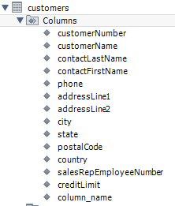
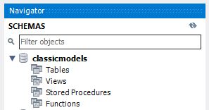
Modifying & Deleting Tables
Purpose - Change (Modify) or Delete (Drop) a tabular structure from the database
Add Column
ALTER TABLE customers ADD column_name VARCHAR(255);
Drop Column
ALTER TABLE customers DROP column_name;
Drop Constraint
DROP CONSTRAINT customers_ibfk_1;
Delete
DROP TABLE IF EXISTS customers;
Notes:
ALTER TABLE customers
ADD column_name VARCHAR(255);
ALTER TABLE classicmodels.customers
DROP column_name;
DROP TABLE IF EXISTS customers;

Slide 9
Manually Insert Values into Table
Purpose - Store persistent values that allow for the Creation/Extraction of data
INSERT INTO classicmodels.customers (customer_number, customer_name, contact_lastname, contact_firstname, phone, addressline1, addressline2, city, state, postalcode, country, salesrep_employeenumber, creditlimit)
VALUES
(103,'Atelier graphique','Schmitt','Carine ','40.32.25','54, rue Royale',NULL,'Nantes',NULL,'44000',’FRA',1370,’2100.00'),
(112,'Signal Gift Stores','King','Jean','7025551838','8489 Strong St.',NULL,'Las Vegas','NV','83030','USA',1166,'71800.00')
Result: SELECT * FROM customers
Notes:
INSERT INTO classicmodels.customers (customer_number, customer_name, contact_lastname, contact_firstname, phone, addressline1, addressline2, city, state, postalcode, country, salesrep_employeenumber, creditlimit)
VALUES (103,'Atelier graphique','Schmitt','Carine ','40.32.25','54, rue Royale',NULL,'Nantes',NULL,'44000','FRA',1370,2100.00),
(112,'Signal Gift Stores','King','Jean','7025551838','8489 Strong St.',NULL,'Las Vegas','NV','83030','USA',1166,'71800.00')

Slide 10
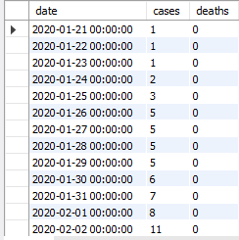
Insert Values into Table from Query
Purpose - Create a query then store those records in a persistent table
Step 1) Create Table to store values
CREATE TABLE jbergmann.us (
`date` DATETIME DEFAULT NULL,
`cases` INT DEFAULT NULL,
`deaths` INT DEFAULT NULL
);
Step 2) create query for records to store in the covide19.us table
INSERT INTO jbergmann.us (`date`,cases,deaths)
SELECT `date`,cases, deaths
FROM covid_19.us;
Result: SELECT * FROM jbergmann.us
=

Slide 11
Update Existing Values in Table
Purpose - Update existing (or missing) values based on known changes to the data set/profile.
UPDATE classicmodels.customers
SET city = 'Omaha', state = 'NE'
WHERE customer_number = 103;
Result: Changes the top (Old) record value to bottom (New) values specified in “SET” keyword
Notes:
UPDATE jbergmann.customers
SET city = 'Omaha', state = 'NE’
WHERE customer_number = 103;

Slide 12
Delete Records in Table
Purpose - Remove/Delete existing records in a table.
Example: DELETE FROM classicmodels.customers
WHERE customer_number = 112;
Result: Select * from customers (Excludes RED record)
Notes:
DELETE FROM jbergmann.customers
WHERE customer_number = 112;

Slide 13
What is a View?
Purpose - A view is a “virtual table” based on the result-set of an SQL statement, saved as a database object for future data creation/extraction.
SQL Views have the following properties:
A view is a named derived table.
CREATE/ALTER/DROP VIEW clauses
View data is not stored, and its query must be run every time it is needed.
Used to call up data without changing its underlying base tables.
Example
CREATE VIEW world.countries_asia AS
SELECT tbl.`name` AS country
FROM world.country AS tbl
WHERE (tbl.continent = 'Asia')
View Usage
SELECT country
FROM world.vw_countries_asia
WHERE country IN ('India', 'China', 'Nepal')
Notes:
CREATE VIEW jbergmann.vw_countries_asia AS
SELECT tbl.`Name` AS country
FROM world.country AS tbl
WHERE (tbl.continent = 'Asia');
SELECT country
FROM jbergmann.vw_countries_asia
WHERE Country IN ('India', 'China', 'Nepal');

Slide 14

Exercises
Data Storage & Manipulation
Create a schema named “missingpersons”
2. Create a table in “missingpersons” schema named “Person”, with the following qualities:
Fields: ID, lastname, firstname, age
Primary Key: ID
Field Constraints: Not Nullable
3. Alter the table to include (add) a “Gender” field.
4. Insert the following records into the table:
(1,'Doe','Jane',42,’F’) ,(2,'Doe','John',57,’M’),
(3,'Presley','Elvis',82,’M') ,(4,'Shakur','Tupac',49,’M’)
5. Delete the record with “lastname” = “Presley”
6. Update the lastname in the record that contains “ID” = 4 to lastname = ‘Crooks’
7. Drop the column “firstname” from the table
8. Drop the “person” table from the “missingpersons” schema.
Notes:
Solutions: “Exercises/Class 3 Exercise – Extracting & Storing Data.sql”
Note: use personal schema – ex. Jbergmann.person

Slide 15
Project Milestones
Query Data for Data Understanding/Relevant Information (Class 2)
Storing and Importing data into MySQL database (Class 3)
Merging and Joining data for analysis (Class 4)
Cleaning Data (Class 5)
Normalize Data & Create Data Model (Class 6)
Analyze Data Quality & Create Data Dictionary (Class 7)
Connect Data to PowerBI Desktop/Cloud, Answer Business Questions Automate data workflow using ETL (Python - Optional) (Class 8)

Slide 16

Class Project
Data Storage & Manipulation
1. To fully understand the current “top games” in the marketplace, the business needs to store additional video game sales data,
Create a table named “console_game_rank” with the appropriate data types and constraints, using the “ConsoleGames_201905.csv” file in the “Class Project/consoles” folder
Create a SQL script that manually inserts the values of the CSV file, into the “console_game_rank” table.
2. The company is not interested in producing Sports Games - Remove these observations from the “console_game_rank” table
3. The CEO insist that “Barbie Adventure Game” is a top-seller. Insert a record with that “Title” into the table, for comparison purposes (mock-up field values)
4. Using the instructions on the “Data Import – MySQL” slide, import the remaining video game files into your personal MySQL schema.
Note: See the “Class Project/consoles” folder for project datasets on Google Drive.
Notes:
Class Project Datasets from https://www.gamerankings.com/

Slide 17
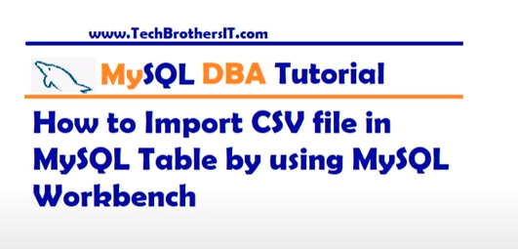
Data Import - MySQL
Purpose - Import Demographic Data, for use with COVID-19 Dataset
STEPS
Analyze Dataset – Column lengths & types
Define & Create Table, based on CSV Columns
Import Data Using “Table Import Wizard”
- Right-Click Table
- Select “Table Data Import Wizard”
Within the “Table Import Wizard”
- Select CSV file
- Select Destination – Create New Table
- Configure Import Setting – Column Types, Encoding (utf-8)
Import Data – Click Next, Monitor Import Log
- Create “Select *” script to check results
Example: https://www.youtube.com/watch?v=vzYFZXI43hM
Notes:
.

Slide 18


